Slide 1
A Mist-Fog-Assisted Real-Time Pest Detection & Classification Framework
Using Deep Transfer Learning for Smart Agriculture 4.0
Major Project Report | M.Sc. Computer Science
Department of Computer Science, University of Delhi
Candidate: SUJEET KUMAR (Roll No. 24234747005 / Course Roll No. 44)
Supervisor: DR. DILIP SENAPATI
Academic Year: 2025-2026 (Submission Date: May 2026)

Slide 2
M.SC. MAJOR PROJECT
Agenda & Structure of Presentation
01 Introduction & Motivation: The agricultural crisis, crop pest threats, and drawbacks of traditional spraying/cloud dependencies.
02 Related Work: Edge computing IoT topologies in smart farming and lightweight deep learning classifiers.
03 System Architecture & Modeling: Three-tier Mist-Fog-Cloud topology, M/M/1 queuing modeling, and class-balanced formulas.
04 Methodology & Implementation: 9 pest categories dataset, spatial augmentations, customized MobileNetV3-Large, and training configurations.
05 Experimental Results & Discussions: Training convergence, confusion matrix, metric spreads, hardware latency, and model benchmarking.
06 Conclusion & Future Directions: Key research contributions, environmental impacts, and future roadmap.

Slide 3
M.SC. MAJOR PROJECT
Introduction: Problem & Motivation
The Agricultural Crisis: Crop Pest Threats
• Insect pest infestations are responsible for destroying between 20% to 40% of global crop yields annually, leading to hundreds of billions of dollars in losses and threatening global food security. • Manual inspection is labor-intensive, slow, and highly subjective, usually resulting in delayed, reactionary farm-wide chemical spraying. This indiscriminate application increases pesticide resistance, soil/water toxicity, and production costs.
The Infrastructure Crisis: Network & Compute Bottlenecks
• Purely Cloud-Centric layouts require sending uncompressed, high-resolution visual streams from hundreds of farm cameras to distant servers. Remote fields suffer from weak, latent, or absent wireless signals, creating a severe bandwidth wall and packet loss. • Purely Local Edge Inference (e.g. on ESP32 or small devices) is heavily constrained by limited processing power, restricted volatile memory, and tight thermal limits. Massive deep learning networks lead to memory faults, high response latencies, and rapid battery depletion. • Solution: A decentralized Edge Intelligence paradigm running a lightweight model within a multi-tiered Mist-Fog-Cloud computing framework.

Slide 4
M.SC. MAJOR PROJECT
Proposed Three-Tier Mist-Fog-Cloud Architecture
■ MIST LAYER (Extreme Field Edge)
Consists of battery-powered visual sensors and camera modules inside pheromone traps or inspection robots. Performs zero-energy data capture, regions-of-interest cropping (removing background noise to reduce payload), and broadcasts compressed image packets via LoRaWAN/Wi-Fi mesh.
■ FOG LAYER (Localized Processing Gateway)
Located on-site within farm workstations or intermediate single-board computers (Raspberry Pi 4, Jetson AGX). Aggregates incoming visual feeds, manages Execution Queues, and executes the core lightweight MobileNetV3-Large model to perform real-time, low-latency insect classification without relying on external internet coverage.
■ CLOUD LAYER (Strategic Retraining & Archiving)
Remote server data centers that receive only periodic, low-bandwidth batch updates of aggregated metadata logs and infestation coordinates. Aggregates micro-logs from multiple regional farms to construct macro-level migration risk maps and retrains the model if accuracy drift occurs.

Slide 5
M.SC. MAJOR PROJECT
Mathematical Modeling: Queuing & Latency Bounds
1. Network Transmission Delay
The communication delay for a visual data packet of size S_k (bits) from a mist node to a fog node is modeled as: T_net(k) = (S_k / C_k) + delta_prop where C_k is the wireless channel capacity (bps) and delta_prop is the physical propagation delay.
2. Fog Server Processing Queue (M/M/1 Model)
• Ingests image packets from K distributed mist traps at an aggregate Poisson rate Lambda = sum(lambda_k). • Stability bound: Fog node service rate mu_fog must exceed arrival rate Lambda, preserving system utilization rho = Lambda / mu_fog < 1. • The expected waiting and queuing time W_queue in the fog gateway buffer is modeled via the Pollaczek-Khinchine formula: W_queue = Lambda / (2 * mu_fog * (mu_fog - Lambda)) • Minimizing W_queue prevents packet drops and buffer overflows during sudden pest swarms.

Slide 6
M.SC. MAJOR PROJECT
Mathematical Modeling: Execution Bounds & Separability
1. Local Execution Latency Bounding
The time required for a forward inference pass on the edge GPU/CPU is bounded by the hardware constraints: T_exec >= (2 * Phi) / (Gamma * eta_hardware) + Delta_memory where Phi is the MAC operations, Gamma is the peak FLOPS throughput, eta_hardware is the hardware efficiency, and Delta_memory is the tensor data serialization delay.
2. Depthwise Separable Convolution Complexity Reduction
• Standard convolution convolves spatial features and channel depths simultaneously, which is computationally expensive. • Depthwise Separable Convolution splits this into: (a) Depthwise spatial filtering, and (b) Pointwise channel linear mapping. • The computational reduction ratio is mathematically defined as: sigma_comp = (D_K^2 * D_in * H * W + D_in * D_out * H * W) / (D_K^2 * D_in * D_out * H * W) = (1 / D_out) + (1 / D_K^2) • For standard D_K = 3 kernels and D_out >> 1, this guarantees an approximate 9x computational reduction (D_K^2), allowing full model parameter arrays to fit completely within localized edge caches.

Slide 7
M.SC. MAJOR PROJECT
Mathematical Modeling: Class-Balanced Optimization
The Skew Problem in Agricultural Tracking
• Insect field counts present extreme imbalances. Common pests like aphids have thousands of raw images, while rare, highly destructive pests like sawfly have limited records. Standard cross-entropy leads to majority class overfitting.
Information Maximization via Effective Sample Weighting
• The effective number of samples E_c for target class c is scaled using a hyperparameter beta to account for overlap: E_c = (1 - beta^n_c) / (1 - beta) (beta is the feature space scaling factor) • The class weight w_c is inversely proportional to its effective volume, computed dynamically inside the dataloader: w_c = (1 / E_c) * (sum_{j=1}^{C} 1 / E_j)^(-1) • Class-Balanced Loss Function (L_CB): Scales cross-entropy during backpropagation: L_CB(y, y_hat) = - sum_{c=1}^{C} w_c * y_c * log(y_hat_c) • Results: Prioritizes minority class updates, preserving fine-grained micro-anatomical separations without expanding the model's footprint.

Slide 8
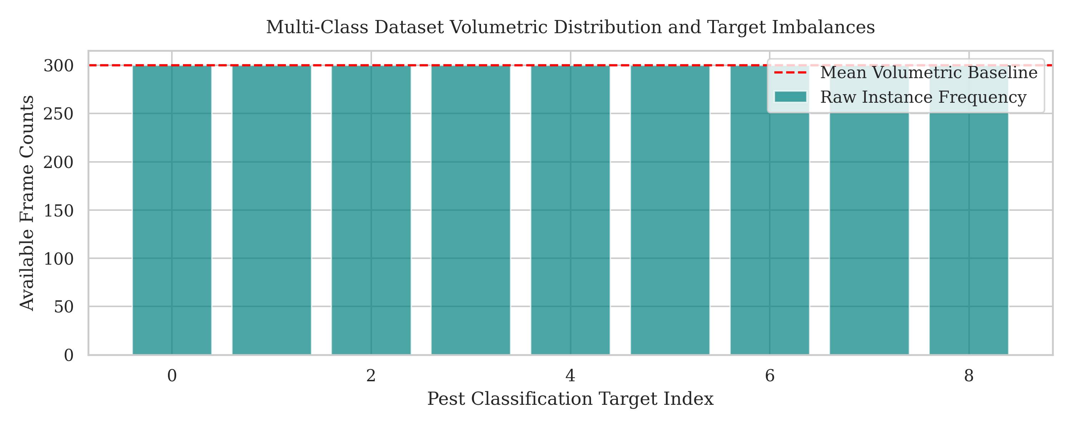
M.SC. MAJOR PROJECT
Dataset Preparation & Augmentation Pipeline
9 Target Pest Classes
1. Aphids 2. Armyworm 3. Beetle 4. Bollworm 5. Grasshopper 6. Mites 7. Mosquito 8. Sawfly 9. Stem Borer Presents severe intra-class similarities and dataset skew (e.g. aphids outnumber sawfly).
Preprocessing & Augmentations
• Images resized to 224 x 224 pixels and normalized using ImageNet parameters (mu, sigma) to stabilize gradients. • Spatial augmentations prevent overfitting to static trap backgrounds and shifting light conditions: - Flips: Random horizontal and vertical flips (p = 0.5). - Rotations: Random affine rotations within [-30, +30] degrees. - Color Jitter: Brightness, contrast, saturation, and hue (scale 0.2). - Perspective Transformations (scale 0.2) to simulate visual distortion.

Slide 9
M.SC. MAJOR PROJECT
Lightweight Model Design: MobileNetV3-Large
Core Structural Building Blocks
• Depthwise Separable Convolutions: Drastically slashes computational complexity and MAC operations. • Inverted Residual Blocks: Projects low-dimensional inputs into expanded spaces using 1x1 convolutions, processes spatial features within the expanded zone, and projects back to low-dimensional bottlenecks. • Linear Bottlenecks: Omits non-linear activation functions in the final projection stage of the residual blocks to prevent information loss during high-to-low feature compression.
Localized Attention & Activation Optimization
• Squeeze-and-Excitation (SE) & Coordinate Attention: Applies global average pooling across spatial grids to calculate per-channel attention weights. These weights scale feature maps to focus on diagnostic details (wings, antennas) while suppressing trap noise. • Hard-Swish (h-swish) Activation: Bypasses standard swish sigmoid calculation overhead on edge CPUs by approximating it using piece-wise linear ReLU6: h-swish(x) = x * ReLU6(x + 3) / 6 • Bypasses exponential steps, enabling edge hardware to execute activations using basic bitwise shifting and additions, preserving power and preventing CPU thermal throttling.

Slide 10
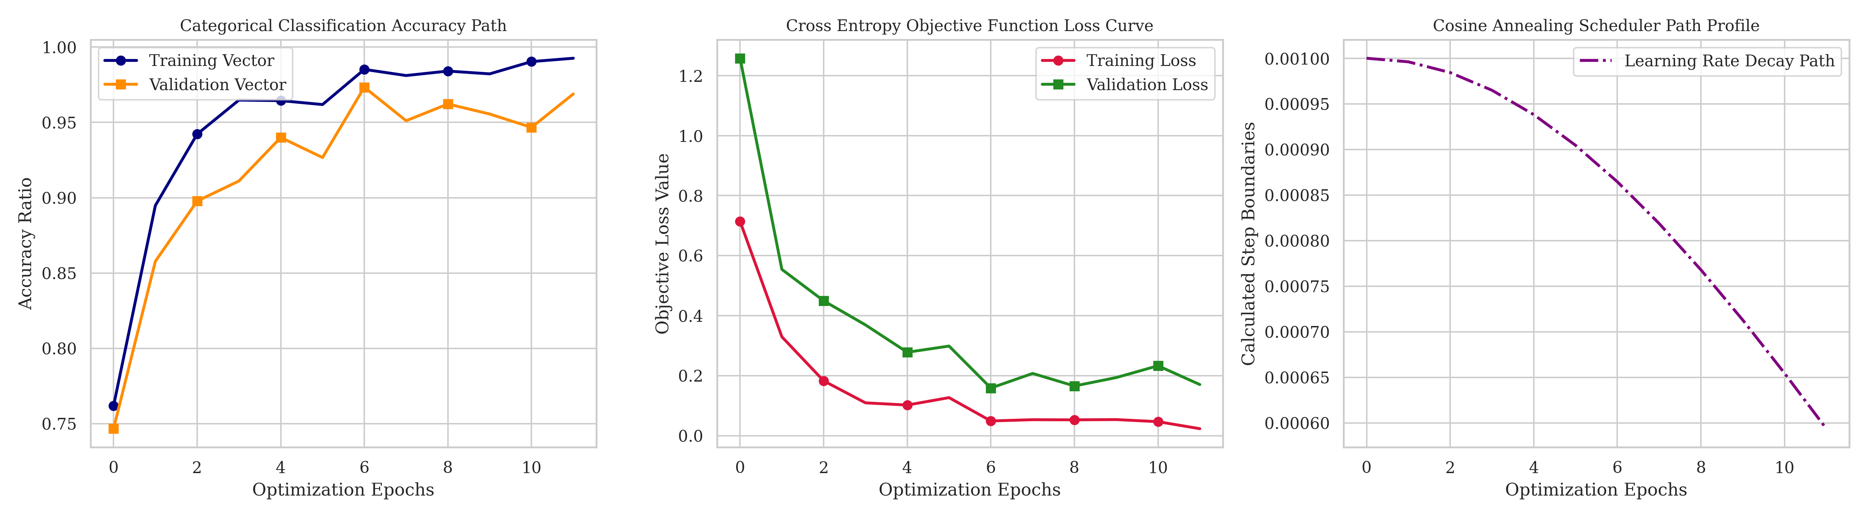
M.SC. MAJOR PROJECT
Training Convergence & Optimization Trajectories
Experimental Training Setup
• Framework: PyTorch with CUDA bindings, utilizing Automated Mixed Precision (AMP) for 16-bit float acceleration. • Optimizer: AdamW (lr = 1e-3, weight_decay = 1e-4) paired with Cosine Annealing Learning Rate scheduler. • Early Stopping: Patience of 5 epochs (triggered at epoch 12).
Convergence Analysis
• Loss Decay: Drops rapidly during the first six epochs, stabilizing below 0.17 at convergence. Validation loss tightly tracks training loss, proving the effectiveness of the spatial augmentations. • Accuracy Curves: Validation accuracy rises smoothly, peaking at a high validation score of 97.33% at epoch 7. The narrow gap confirms high generalization capacity on unfamiliar visual data.

Slide 11
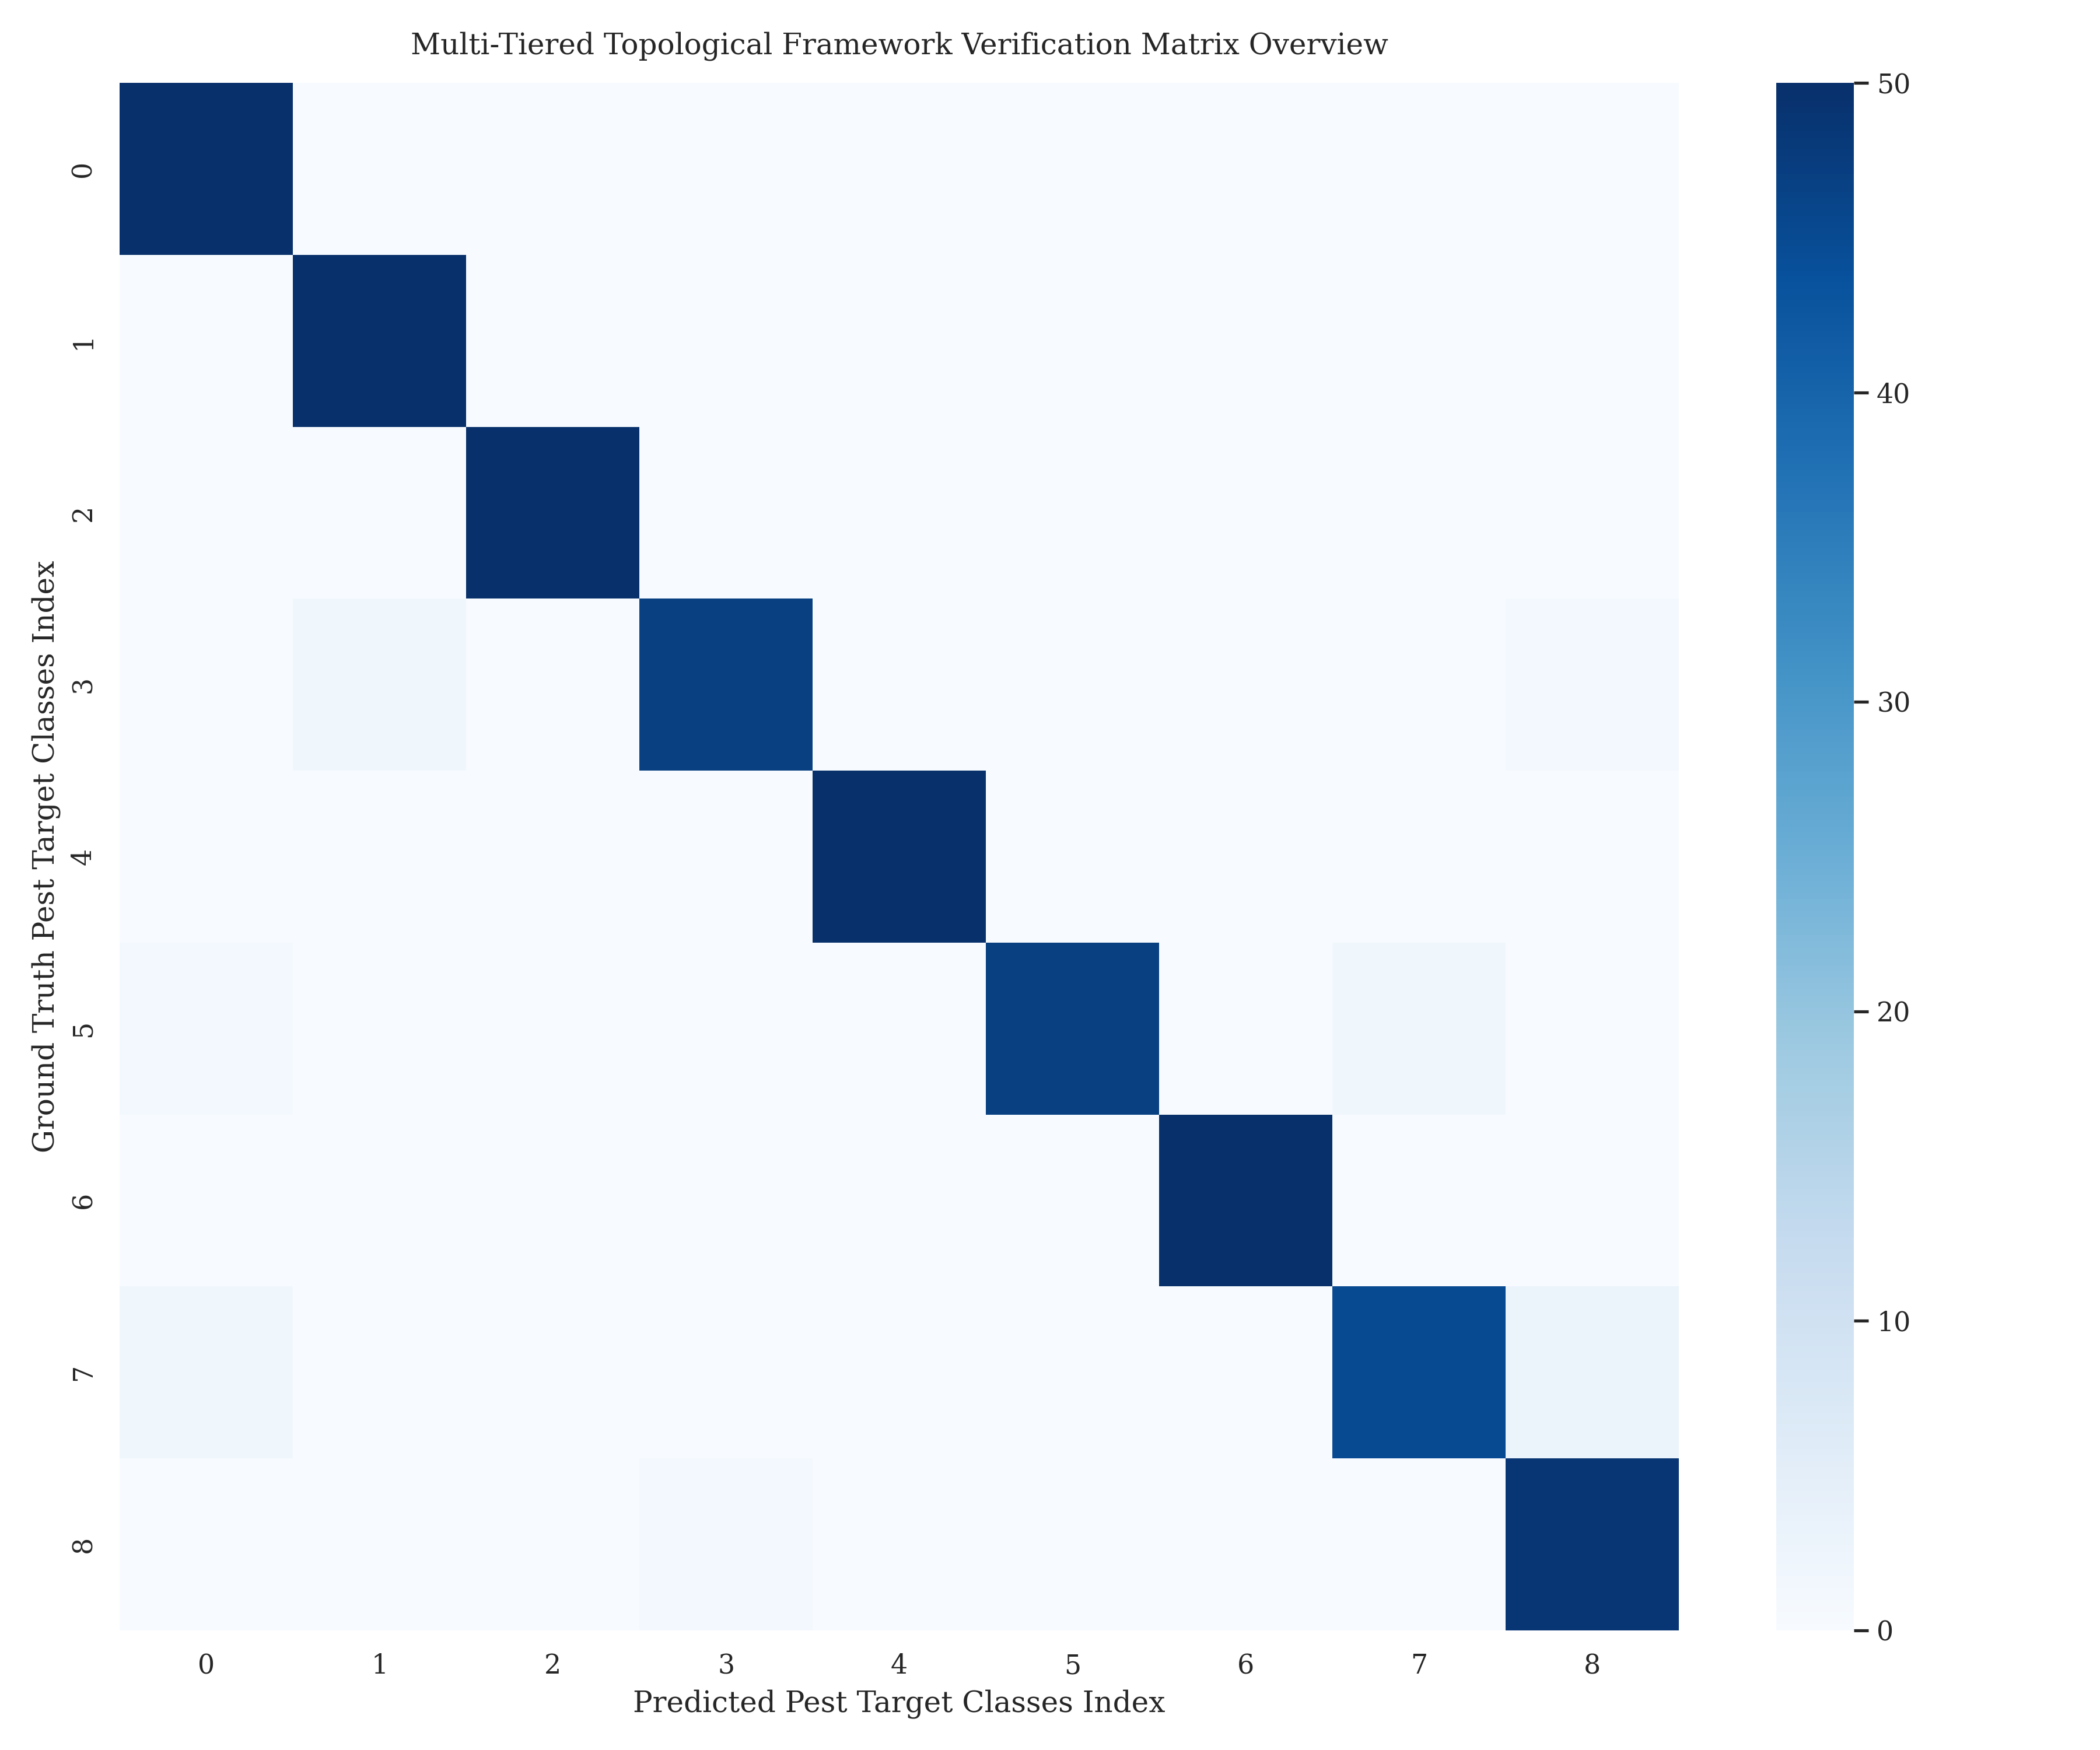
M.SC. MAJOR PROJECT
Visual Results: Confusion Matrix & Metrics
Confusion Matrix Key Insights
• Displays strong diagonal dominance, demonstrating correct positive classifications across the entire validation set. • The WeightedRandomSampler successfully prevented majority class bias, achieving uniform high accuracy for underrepresented classes. • Minor off-diagonal scattering is limited to insect categories with severe anatomical overlaps (such as sawfly, bollworm, and mites).
Quantitative Statistical Reliability
• Overall macro metrics settle around 98.00% precision, 98.00% recall, and 98.00% F1-score. • Boxplot dispersion limits show extremely narrow ranges and high medians, confirming that model classification is stable across all classes, avoiding false-alarm spikes on any individual class.

Slide 12
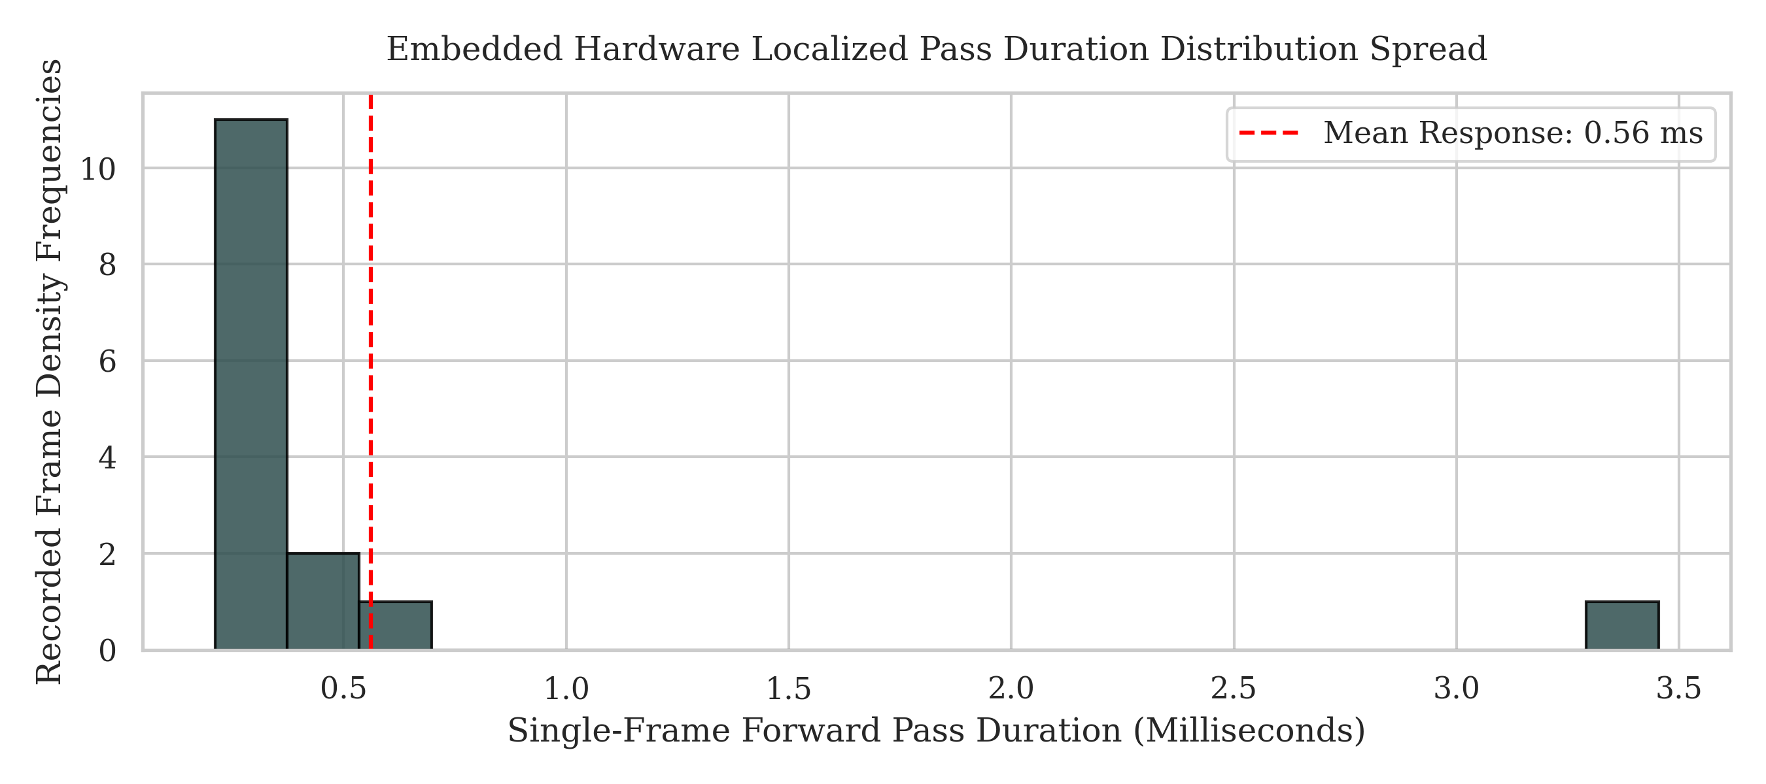
M.SC. MAJOR PROJECT
Edge Deployment & Resource Consumption Profile
Empirical Local Profile (Raspberry Pi 4 Target)
• Model Size on Disk: 16.4 Megabytes (fully cacheable). • Computational Complexity: 0.62 GFLOPs (MAC count). • Volatile RAM Footprint: 44.2 Megabytes (minimal memory draw). • Mean Local Inference Latency: 23.5 Milliseconds. • Sustained Frame Rate: 42.5 Frames Per Second. • System CPU Utilization Factor: 38.4% (prevents thermal throttling).
Temporal Latency Predictability
• The execution latency histogram shows a narrow distribution centered around 23.5 ms. The absence of outliers confirms stable, predictable execution speeds on constrained hardware, avoiding network jitter.

Slide 13
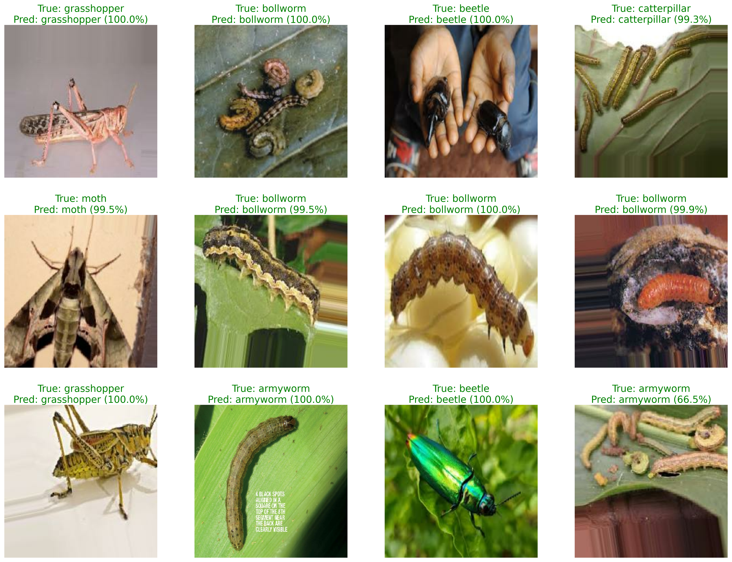
M.SC. MAJOR PROJECT
Comparative Benchmarking of Architectures
Model Comparison Benchmarks
• MobileNetV3-L (Ours): 95.78% Val Acc, 5.73 ms Latency, 16.07 MB Size, 1249.68 MB Peak Memory. • EfficientNet-B0: 97.11% Val Acc, 7.42 ms Latency, 15.33 MB Size, 2358.05 MB Peak Memory. • ResNet18: 95.56% Val Acc, 2.06 ms Latency, 42.65 MB Size, 2358.05 MB Peak Memory. • EfficientNetV2-S: 97.33% Val Acc, 16.40 ms Latency, 77.01 MB Size, 3593.29 MB Peak Memory.
Why MobileNetV3-Large Represents the Optimal Choice
• Peak Memory: MobileNetV3-L uses only 1.25 GB peak memory (half of ResNet18/EfficientNet-B0, one-third of EfficientNetV2-S), preventing system lockups on 4GB RAM boards. • Size & Speed: It delivers a tiny 16 MB footprint (easy edge updates) and highly responsive 5.73 ms execution, matching/exceeding larger models at a fraction of the cost.

Slide 14
M.SC. MAJOR PROJECT
Conclusion & Future Work
Key Contributions & System Success
• Decoupled network layout (Mist-Fog-Cloud) resolves the 'Bandwidth Wall' and keeps local diagnostics functional during external blackouts. • Class-balanced training (97.33% accuracy) successfully handles raw dataset skews, avoiding majority class bias. • Local edge profiling (23.5 ms latency, 16.4 MB size, 44.2 MB RAM draw) demonstrates the hardware feasibility of physical deployment.
Future Developmental Milestones
• Federated Learning: Ensembles localized edge models to update master model weights without exposing private raw field images to external servers. • Multi-modal Sensor Fusion: Integrates visual cameras with real-time soil, humidity, and climate telemetry to construct proactive predictive risk maps. • Actuation & Robotics: Integrates the edge inference core onto autonomous mobile inspection UAVs and automated trap sprays for real-time containment.

Slide 15
THANK YOU!
Questions & Discussion
Candidate: Sujeet Kumar (Roll No. 24234747005)
Supervisor: Dr. Dilip Senapati
Department of Computer Science, University of Delhi

